Slide 1
Industrial Monitoring and Control System Using CAN Protocol
Submitted By:
Mr. Chinmay Jadhav. 240840130007
Mr.Kailashnath M Sugre. 240840130012
Mr. Saurav Makde. 240840130036
Ms.Ujani Mukherjee. 240840130046
Mr. Valleboina Durgaprasad. 240840130050
Under the guidance
Of
Tarun Bharani

Slide 2
Introduction
Project Overview
The project involves two STM32 microcontrollers communicating over a CAN bus:
Sensor Node (STM32 Board 1): Reads atmospheric pressure and temperature from the BMP280 sensor via I2C and sends data over the CAN bus.
Display Node (STM32 Board 2): Receives the sensor data over CAN and displays it on an OLED screen using I2C.

Slide 3
ABSTRACT
An Industrial Monitoring and Control System using the CAN protocol enables machines and
sensors in a factory to communicate efficiently and reliably. The Controller Area Network
(CAN) is a robust communication protocol that reduces wiring complexity and enhances
real-time monitoring and control of industrial equipment. This project implements a CAN-based
system using STM32 microcontrollers, CAN bus modules, a BMP280 sensor, and an OLED
display to demonstrate real-time data acquisition, transmission, and display.
The transmitter STM32 board reads environmental parameters like temperature and pressure from
the BMP280 sensor and sends the data via the CAN bus. The receiver STM32 board processes the
received data and displays it on an OLED screen, providing real-time monitoring. The system
ensures error-free data transmission using the CAN protocol’s built-in error detection and message
prioritization features.

Slide 4
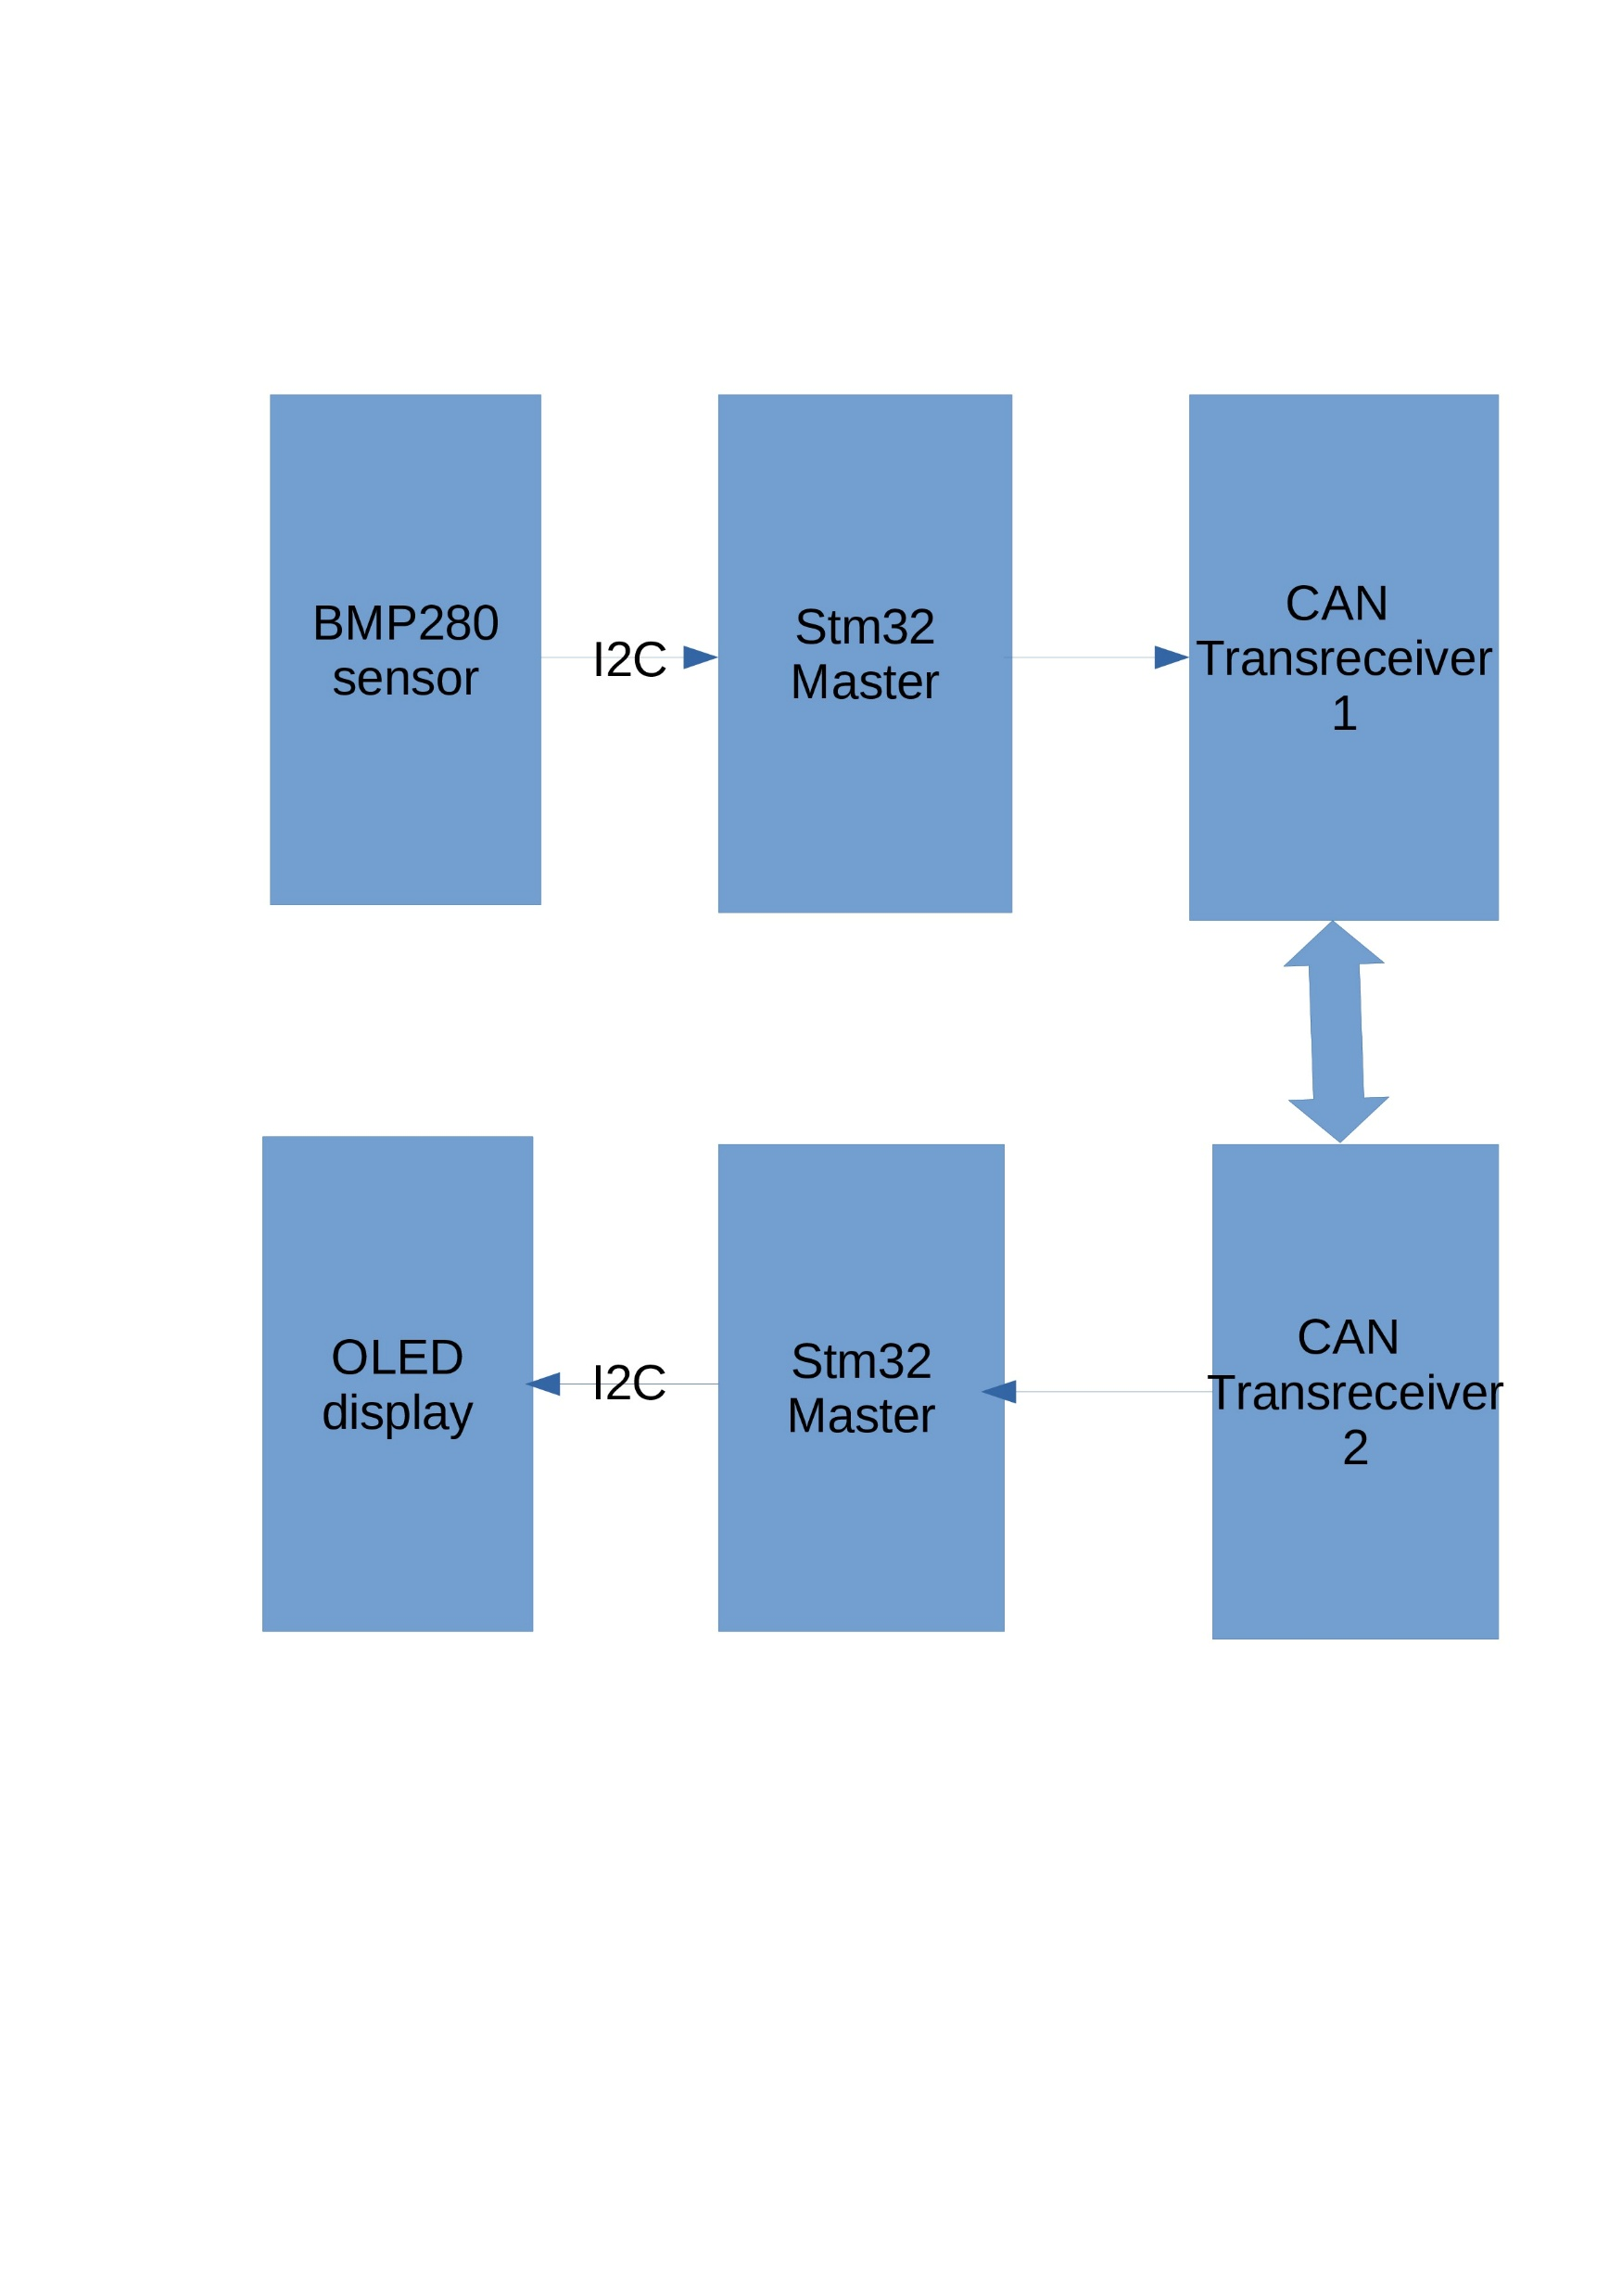
Block diagram of Project

Slide 5
Transmitter STM32 (Reading BMP280 and Sending Data via CAN) I2C
Interface Configuration
The BMP280 sensor operates using the I2C protocol.
The STM32 microcontroller’s SDA (data) and SCL (clock) pins are assigned to enable
communication with the sensor.
The I2C peripheral is initialized in STM32CubeIDE, setting the clock speed and addressing mode.
CAN Interface Configuration
The CAN peripheral is initialized to enable message transmission over the CAN bus.
The CAN_TX and CAN_RX pins are mapped correctly to ensure seamless communication.
The CAN baud rate is set appropriately to match the receiver.
Filters and interrupts are configured for efficient data transmission.

Slide 6
GPIO Configuration
Additional GPIO pins are set up to provide power to the sensor and manage control signals.
The microcontroller’s onboard LED is programmed to blink when data transmission occurs, serving
as an activity indicator.
Receiver STM32 (Receiving CAN Data and Displaying on OLED)
CAN Interface Configuration
The receiver STM32 is programmed to listen for incoming data on the CAN bus.
The same CAN_RX and CAN_TX pins are configured for message reception.
Filters are set up to accept only relevant messages.
The interrupt service routine (ISR) is enabled to handle incoming data efficiently.
I2C Interface Configuration
The OLED display communicates via I2C protocol.
The STM32 microcontroller acts as a master device to send display updates.

Slide 7
GPIO Configuration
Additional GPIO settings are configured for controlling the OLED display.
A user button is set up for potential interaction, such as switching between different display modes.
Code Implementation
The firmware for the STM32 microcontrollers is written in Embedded C using the STM32 HAL
(Hardware Abstraction Layer) library. The code ensures smooth operation of data acquisition,
transmission, reception, and display updates.
Transmitter Code (Sensor Data Acquisition and Transmission)
Initialize the BMP280 sensor using the I2C protocol
Configure I2C in master mode.
Set up BMP280-specific registers to read temperature and pressure data.
Read temperature and pressure data from the sensor
Use HAL functions to retrieve raw sensor values.
Convert raw data to readable temperature and pressure values using calibration formulas.
Format data into CAN message frames
Store sensor values in a structured format within a CAN message.
Assign appropriate message IDs and priorities.
Send the formatted data using the CAN transmit function
Load the data into the CAN transmit buffer.
Enable transmission using HAL_CAN_Transmit() function.
Implement error handling to ensure reliable communication
Configure error-detection mechanisms using CAN error status registers.

Slide 8
Receiver Code (Processing and Displaying Data)
Initialize the CAN module and set up message filtering:
Define message acceptance criteria to filter unnecessary data.
Enable interrupts for handling incoming messages in real-time.
Receive data frames from the transmitter over the CAN bus:
Read incoming messages using HAL_CAN_GetRxMessage().
Check message integrity and validity before processing.
Extract temperature and pressure values from the received messages:
Parse the received CAN frame to retrieve temperature and pressure values.
Format the extracted data for display:
Convert numerical values into a readable format.
Prepare display strings for the OLED.
Send formatted data to the OLED screen for real-time monitoring:
Use I2C communication to update the OLED display.
Implement periodic refresh to ensure updated values are shown.
Monitoring CAN Signals
Use an oscilloscope or logic analyzer to visualize CAN bus signals.
Confirm that message timing and structure follow the expected format.

Slide 9
BMP280 sensor using STM32 and I2C
Read Calibration Data
Reads 24 bytes from 0x88 register.
Extracts temperature (dig_T1, dig_T2, dig_T3) and pressure (dig_P1 to dig_P9) calibration values.
Read Raw Sensor Data
Writes 0x27 to 0xF4 to start measurement.
Waits 10ms, then reads 6 bytes from 0xF7.
Extracts 20-bit raw temperature and pressure values.
Temperature Compensation
Uses calibration data to adjust temperature.
Returns temperature in °C × 100.
Pressure Compensation
Uses calibration values and fine temperature to calculate actual pressure.
Returns pressure in Pascals (Pa).
O

Slide 10
Can transmission process
This STM32-based program reads temperature and pressure from a BMP280 sensor via I2C and transmits the data over a CAN bus. It configures peripherals including CAN, I2C, and UART, and supports both sender and receiver modes. The sender reads sensor data, formats it, and transmits it using CAN. The receiver processes incoming CAN messages, extracts temperature and pressure values, displays them on an SSD1306 OLED, and prints them via UART. The program also includes CAN filter configuration, error handling, and basic initialization functions for smooth communication.

Slide 11
Oled display
This STM32 program reads BMP280 sensor data via I2C and transmits it over CAN.
The receiver extracts temperature and pressure, displays them on an SSD1306 OLED,
and prints via UART. The SSD1306 driver initializes the display, sets addressing modes, contrast,
and scan direction, and supports pixel drawing, text rendering, clearing, inversion, and scrolling.
I2C handles OLED communication using HAL. CAN filters and I2C readiness checks ensure stability.
Key functions include SSD1306_Init, SSD1306_UpdateScreen, SSD1306_Fill, and SSD1306_DrawPixel.
The program enables real-time sensor display and structured data handling for embedded applications.

Slide 12
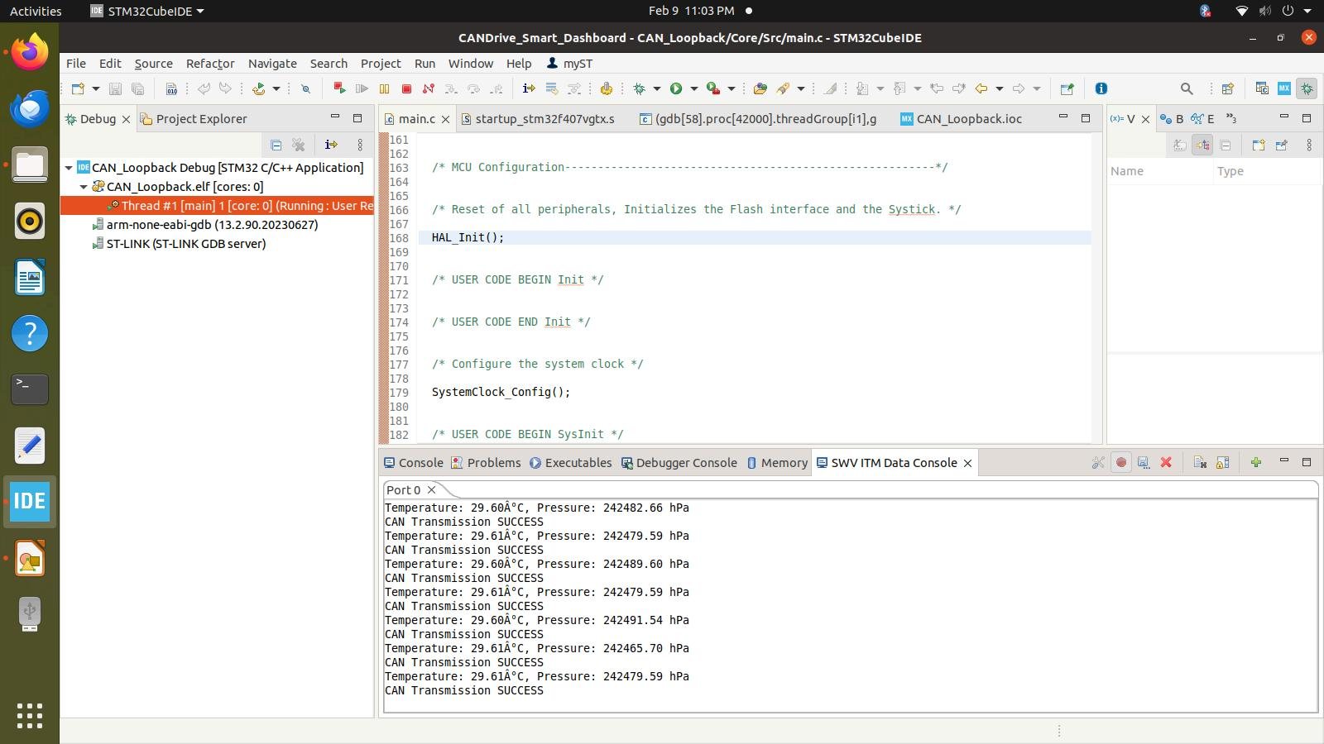
Results

Slide 13
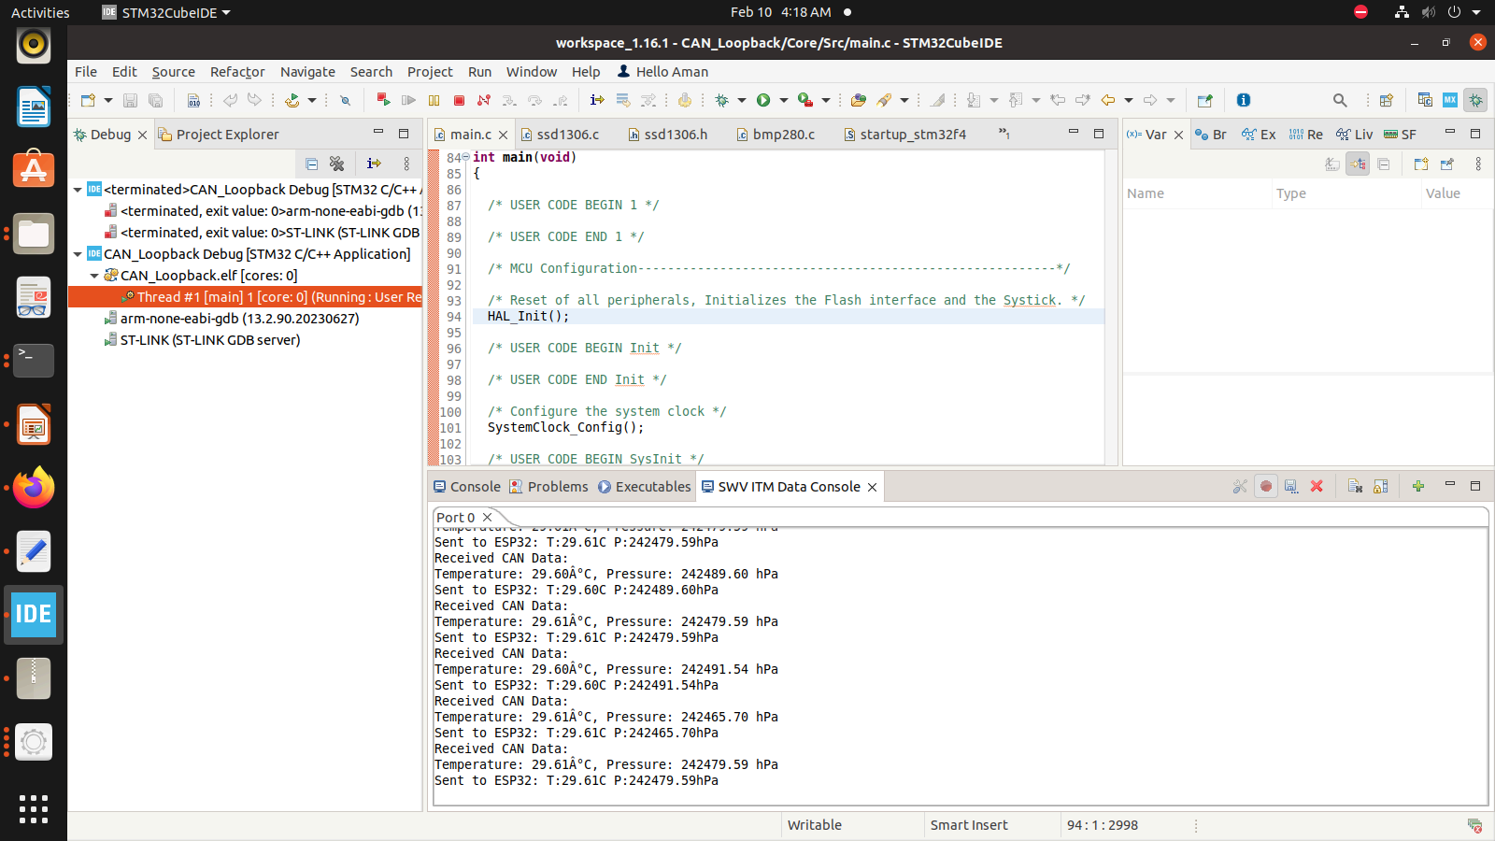
Receiver result

Slide 14
THANK YOU

